Slide 1
UNSW Global Project Kick-Off
Robert Mulroney
Calumo Consultant

Slide 2
What is Calumo?
Web / Mobile Financial reports
MS-Office integrated reporting
Author reports in excel
Planning & Forecasting
Month End reporting
Report preparation – Build once use forever – Automate
HR Reporting
Executive reports
Dashboards
Data-visualization
Sensitivity & What-if Analysis
KPI Management
A single source of truth.
CALUMO makes it easy for you to deliver outcomes to the business

Slide 3
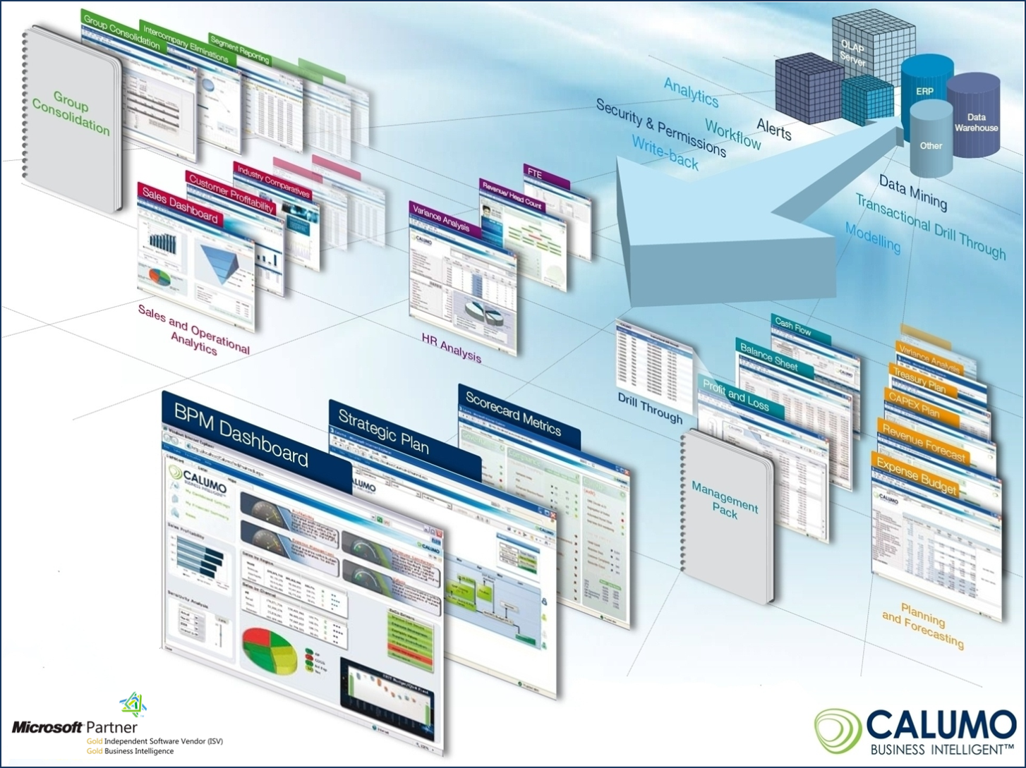
BI for Finance

Slide 4



















Architecture
Triggers
Operational Reporting
Planning
Forecasting
Ad-Hoc Analytics
Scorecards
Dashboards
Work Flow/ Alerting
Statutory Reporting
Modes
CALUMO Client (Ribbon)
CALUMO Client (Zero Footprint)
Interface
Authoring
Desktop apps
Browsers
Cloud
CALUMO-as-a-Service
Agile | Secure | Scalable | Rapid | Cost effective
Source

Slide 5
The Language of Calumo
Cube - Cube is a multi dimensional data structure composed of dimensions and measure groups. The intersection of dimension and measure groups contained in a cube returns the dataset.
Measure - Literally it refers to measured data such as measured dollars or number of sales. A unit-bearing data type – The types of numbers stored in the cube.
Dimension - A collection of members, positions, or units of the same type. In a multidimensional data set, every data point is associated with one and only one member from each of multiple dimensions. Dimensions are frequently organized into one or more hierarchies, though this is not a logical requirement.

Slide 6
The Language of Calumo
Member - An element, position, or unit within a dimension.
Hierarchy - An organization of members into a logical tree structure, with each member having at most one “parent” member and an arbitrary number of “children” members.
Slice / Slicer – a Filter / filtered set. A slice is a subset of a multi-dimensional array. The set of data associated with the selected Dimension members.
Drill-up/down - Navigating towards/away from the root of a hierarchy.

Slide 7

The Cube is a Lie
Cube – a delicious cake of data.
Dimension – the knives by which the cake is cut.
Member – the lines on which the cake is cut.
Hierarchy – layers of the cake.
Slice – the piece I’m eating.

Slide 8
Calumo@ UNSW Global

Slide 9
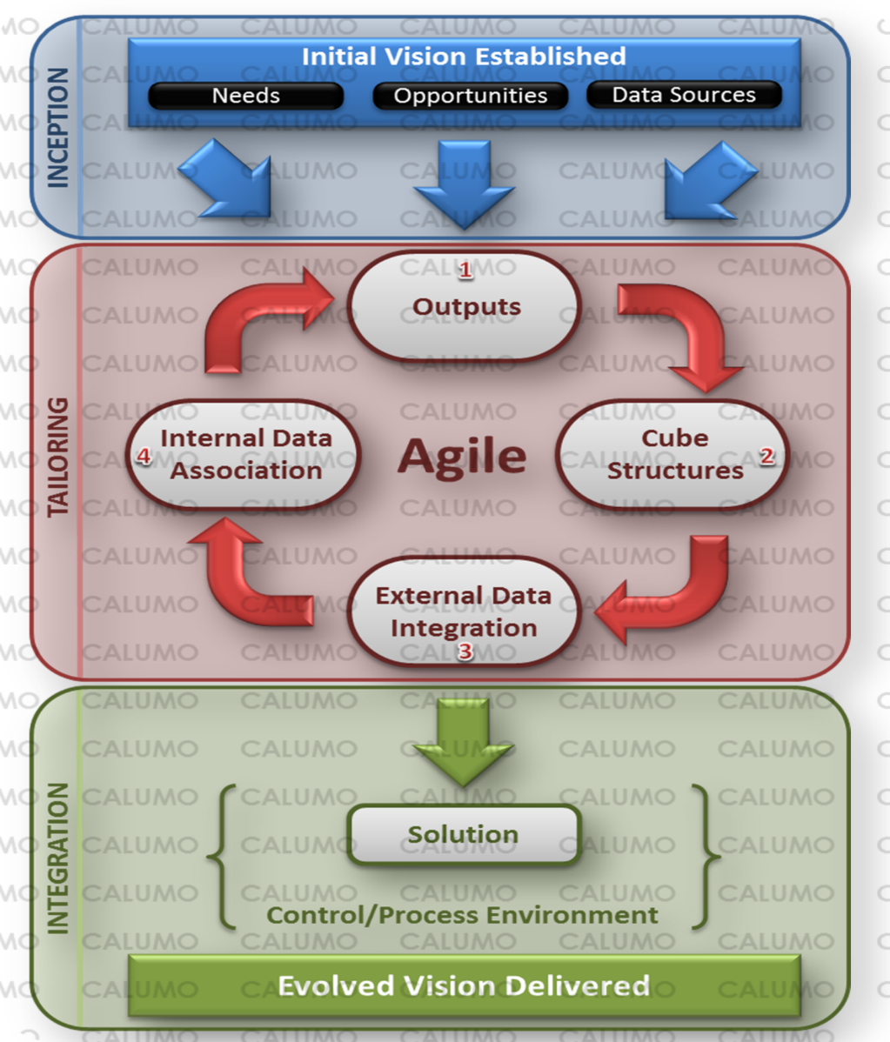
The Agile Methodology
Individuals and interactions over processes and tools
Working software over comprehensive documentation
Customer collaboration over contract negotiation
Responding to change over following a plan
Early and continuous delivery of valuable software

Slide 10
The Agile Methodology
Our highest priority is to satisfy the customer through early and continuous delivery of valuable software.
Welcome changing requirements, even late in development. Agile processes harness change for the customer's competitive advantage.
Deliver working software frequently, with a preference to the shorter timescale.
Business people and developers must work together daily throughout the project.
Build projects around motivated individuals. Give them the environment and support they need, and trust them to get the job done.
The most efficient and effective method of conveying information to and within a development team is face-to-face conversation.
Working software is the primary measure of progress.
Agile processes promote sustainable development. The sponsors, developers, and users should be able to maintain a constant pace indefinitely.
Continuous attention to technical excellence and good design enhances agility.
Simplicity--the art of maximizing the amount of work not done--is essential.
The best architectures, requirements, and designs emerge from self-organizing teams.
At regular intervals, the team reflects on how to become more effective, then tunes and adjusts its behavior accordingly.
Notes:
Early and Continuous – Starting today. Delivery of report with a question is this right?
Deliver of working software frequently – Quick wins.

Slide 11
What to expect in this project.
Lots of questions
Quick releases
Iteration - Release -> Refine -> Release -> Refine
To contribute to the development

Slide 12
Project Charter
A Mission Statement:
Scope
Objectives
Participants
Reasons for undertaking the project
Target project benefits
Objectives and constraints of the project
Identities of the main stakeholders
In-scope and out-of-scope items
High level risk management plan
Communication plan
High level budget and spending authority

Slide 13
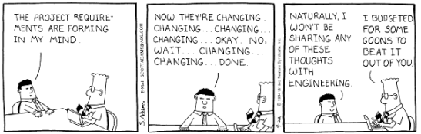
Specific Outcomes
Defining Success….
Measureable / Quantifiable
Deliverable / Achievable
Cost Effective
Solution Oriented

